Slide 1
KUBERNETES WITH MICROSERVICES
21ST OCTOBER 2020

Slide 2
MICROSERVICES

Slide 3
AGENDA
WHAT IS MONOLITHIC APPLICATION
CHALLENGES
NEED FOR MICROSERVICES
WHAT ARE MICROSERVICES
MICROSERVICES ARCHITECTURE
FEATURES
ADVANTAGES
WHAT ARE APIs
DIFFERENCE BETWEEN APIs AND MICROSERVICES
BASICS OF DEVOPS
INTRO TO DOCKER
CASE STUDY

Slide 4
MONOLITHIC ARCHITECTURE
Monolithic application is self-contained and independent from other computing applications.
Monolithic application describes a software application that is designed without modularity.
Is a big container where in all software components of an application are assembled together and tightly packaged.

Slide 5
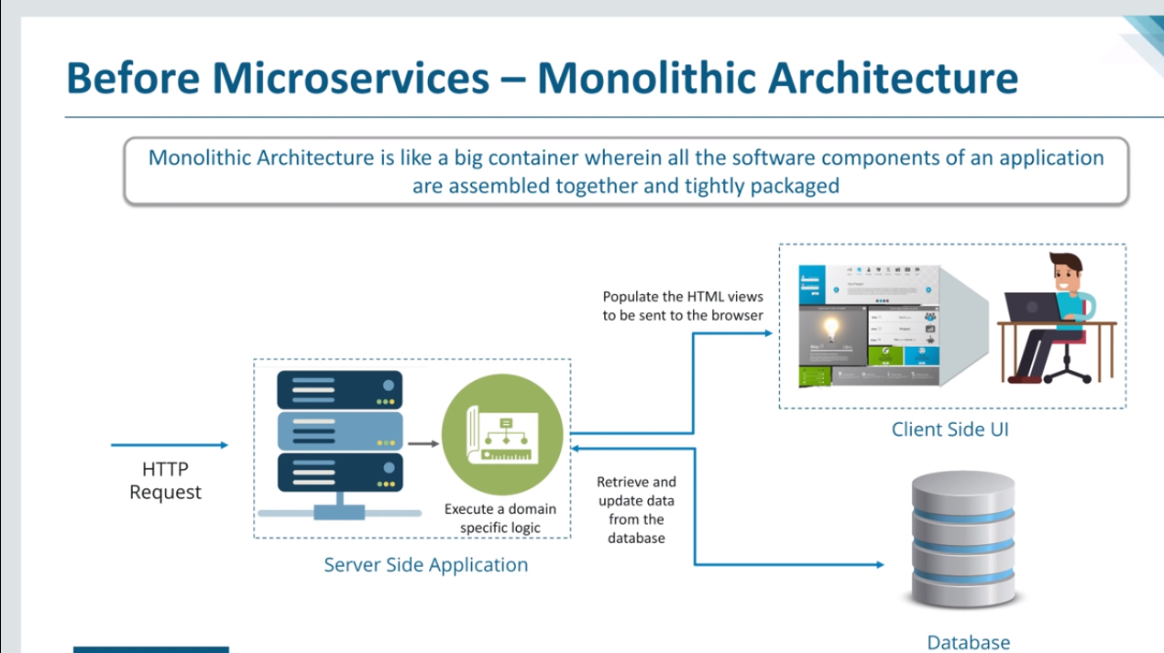
MONOLITHIC ARCHITECTURE

Slide 6
CHALLENGES
Large and Complex Applications
Slow Development
Blocks Continuous Development
Unreliable
Inflexible
Unscalable

Slide 7
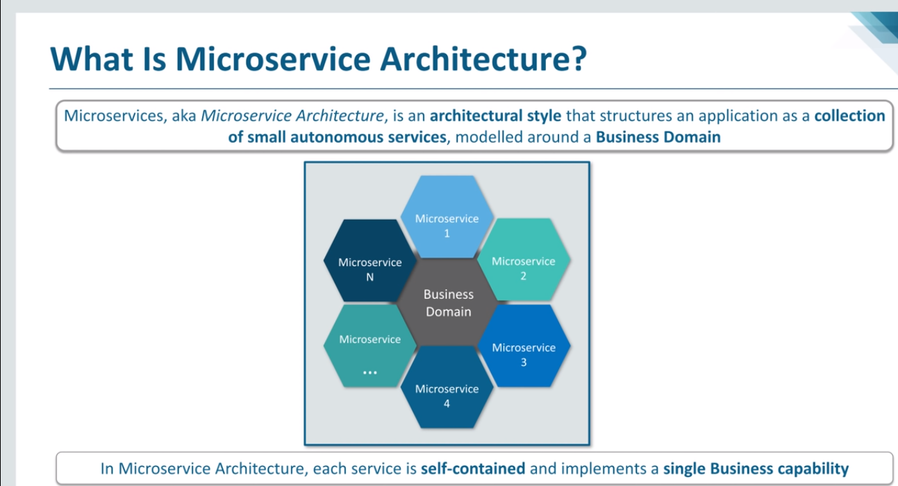
MICROSERVICE

Slide 8
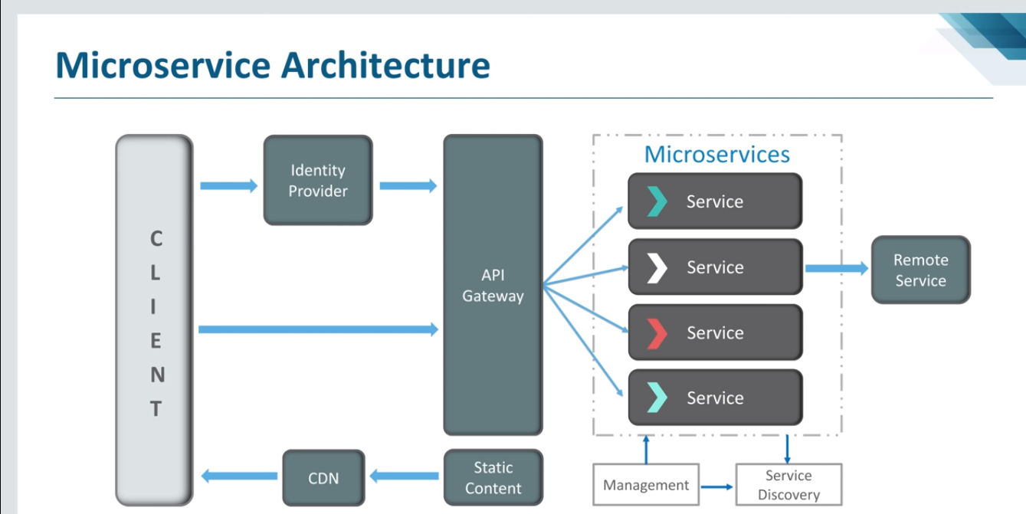
ARCHITECTURE

Slide 9
FEATURES OF MICROSERVICE
SMALL FOCUSED
LOOSELY COUPLED
LANGUAGE NEUTRAL
BOUNDED CONTEXT

Slide 10
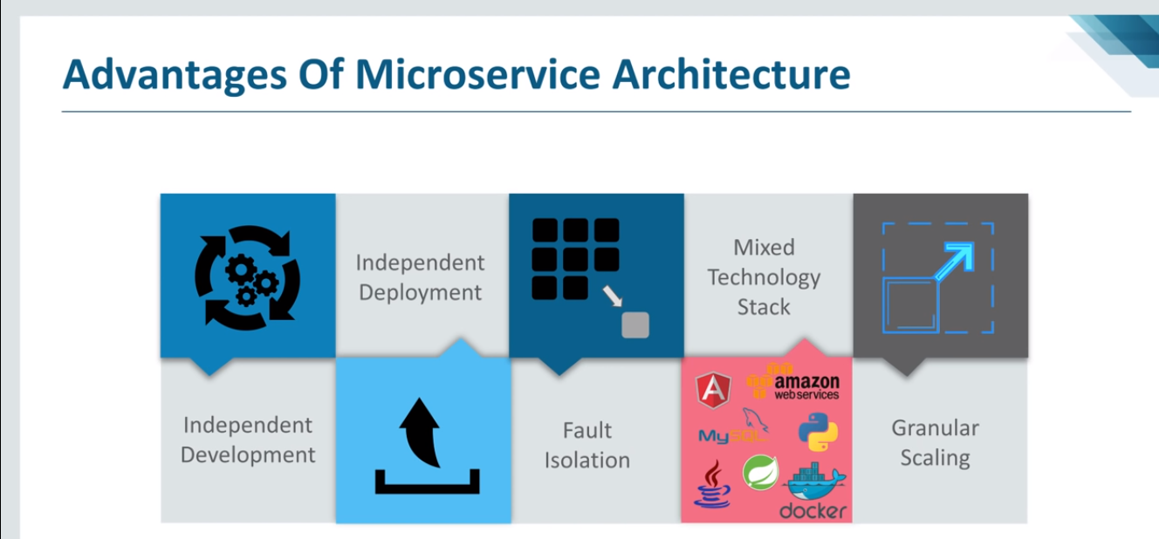
ADVANTAGES

Slide 11
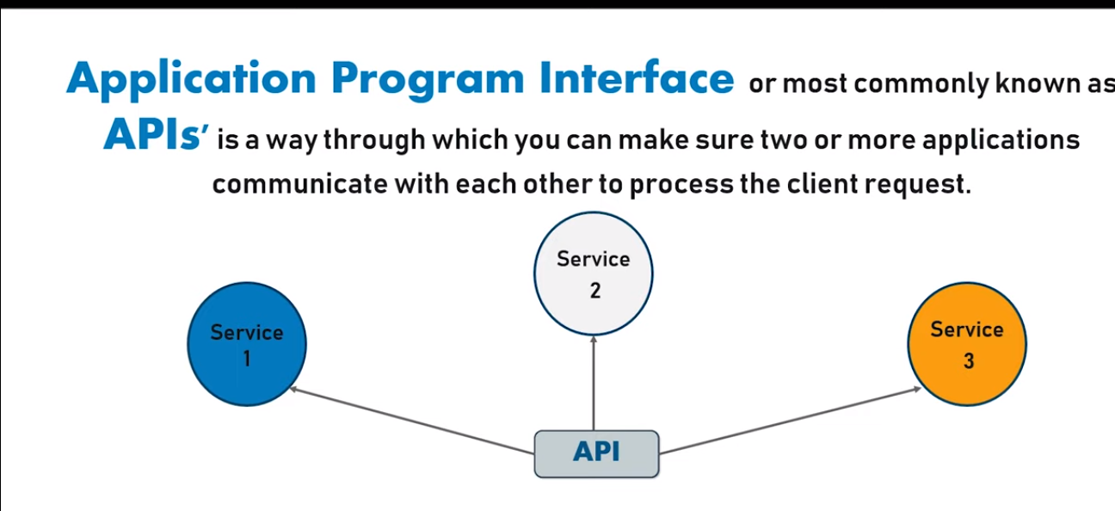
WHAT ARE APIs?

Slide 12
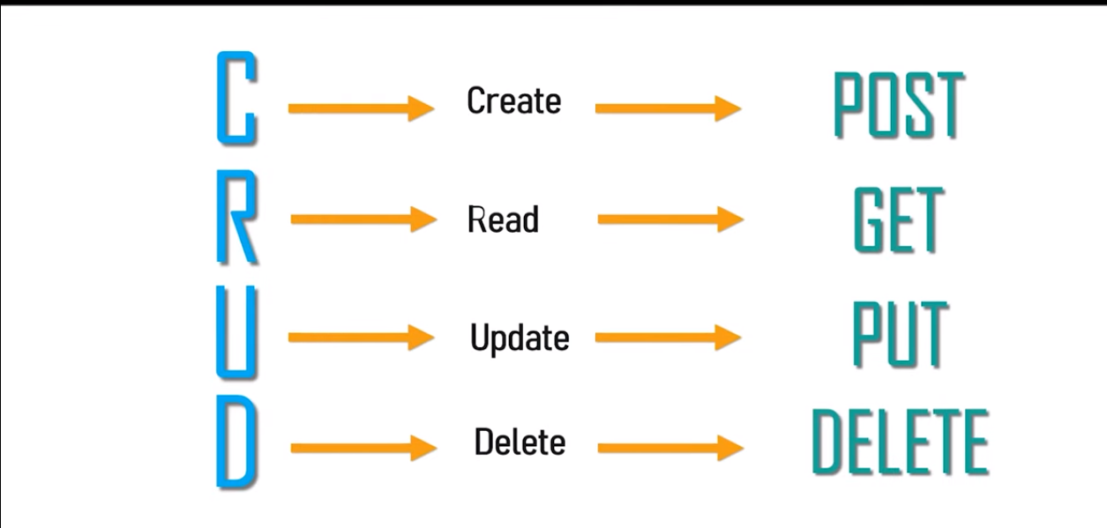
HTTP METHODS

Slide 13
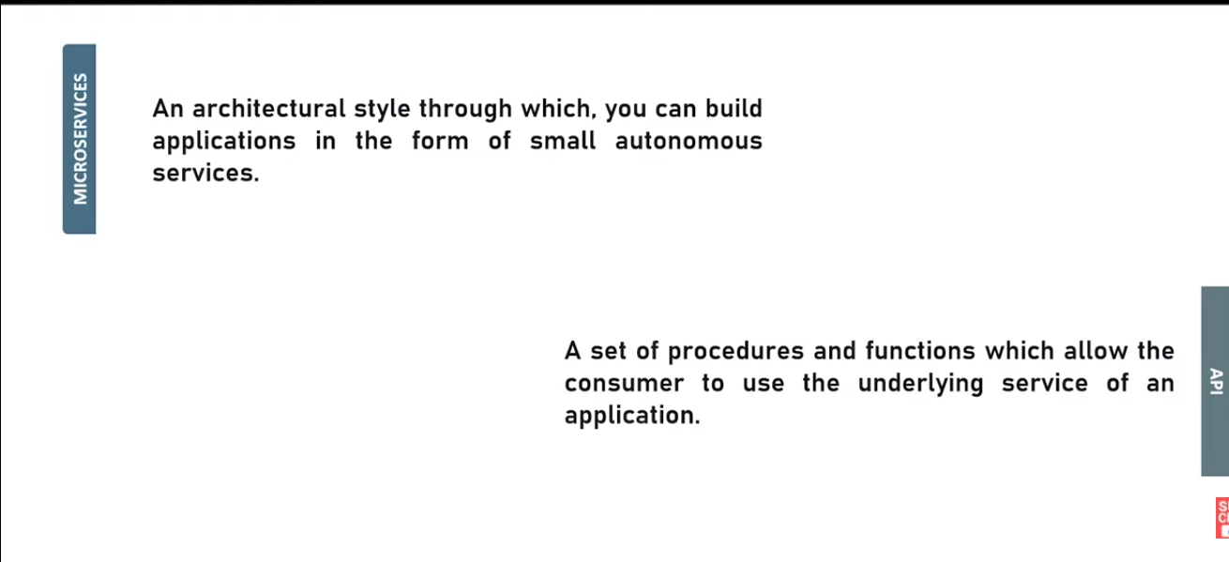
MICROSERVICES VS API

Slide 14
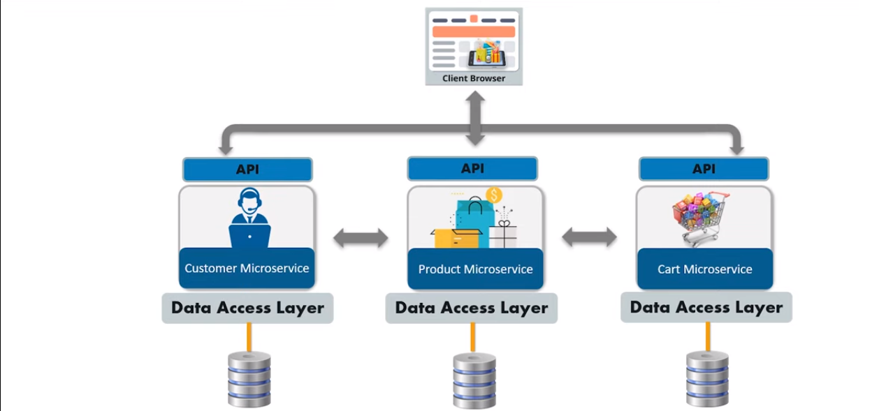
API IN MICROSERVICE

Slide 15
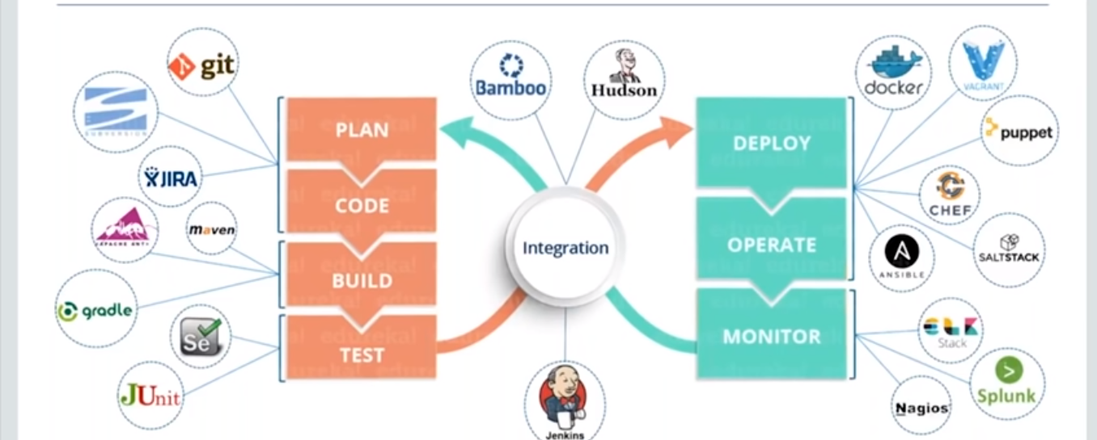
What is devops

Slide 16
Case study

Slide 17
Questions????

Slide 18
Thank you!!!!!

Slide 19
kubernetes

Slide 20
AGENDA
WHAT IS KUBERNETES
FEATURES
ARCHITECTURE
API SERVER
COMPONENTS
SERVICES
PODS
SECRETES
YAML
DEPLOYING AN IMAGE INTO AKS
CASE STUDY

Slide 21
docker
Docker is an open platform for developing, shipping & running distributed applications, whether on laptops, data center VMs or cloud.
Docker provides the ability to package and run an application in a loosely isolated environment called a container.
The Docker Platform consists of multiple product/tools, including the Docker Engine, Images, Containers, and Hub, among others.

Slide 22
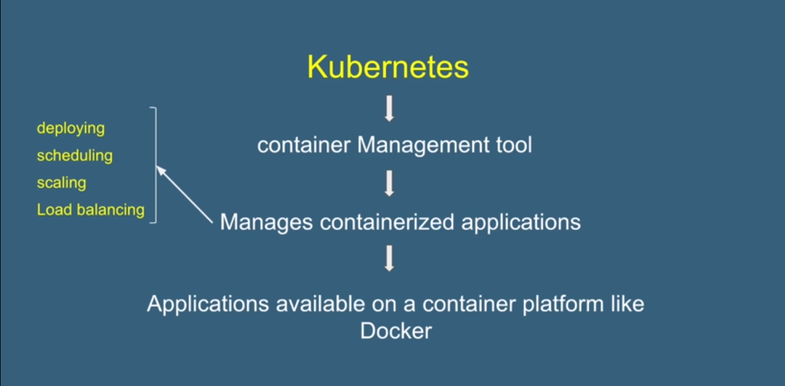
Kubernetes

Slide 23
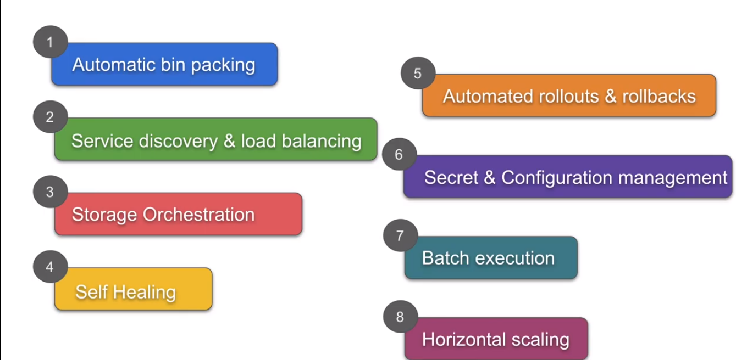
Features

Slide 24
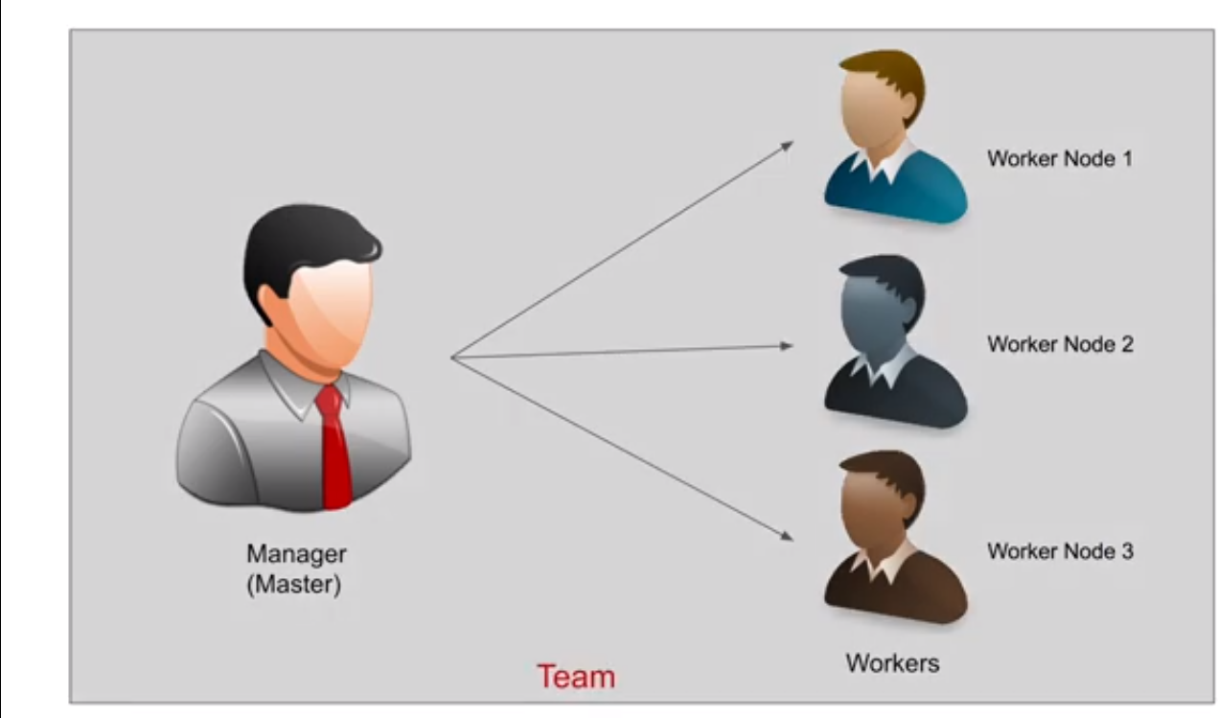
Kubernetes architecture

Slide 25
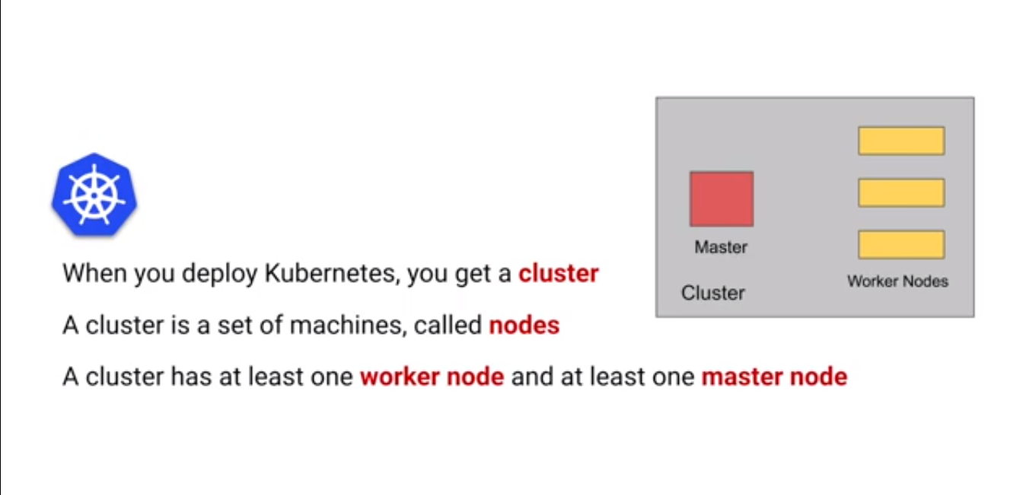
architecture

Slide 26
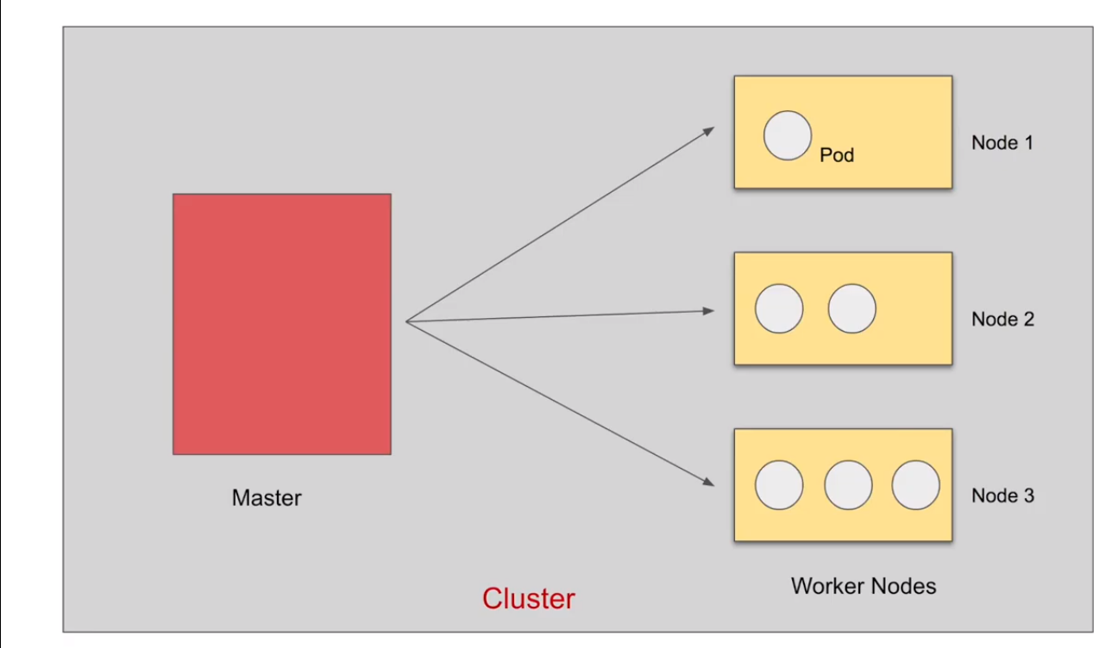
architecture

Slide 27
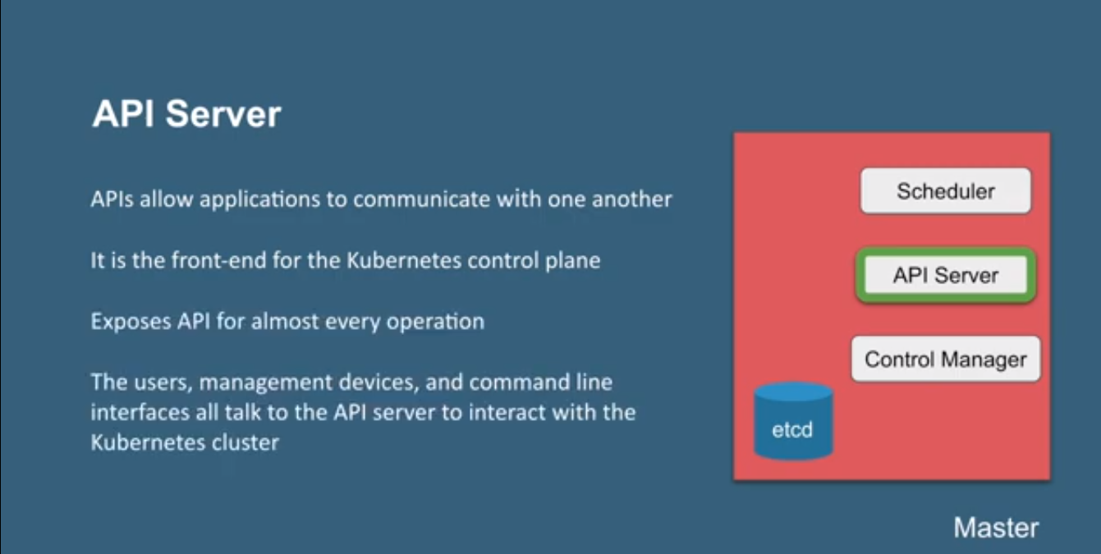
API server

Slide 28
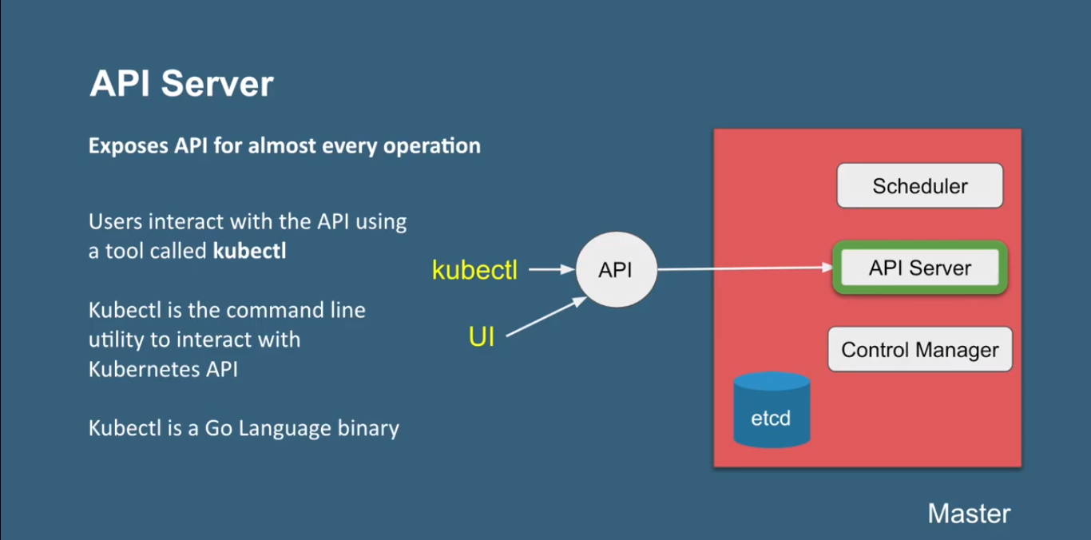
API server

Slide 29
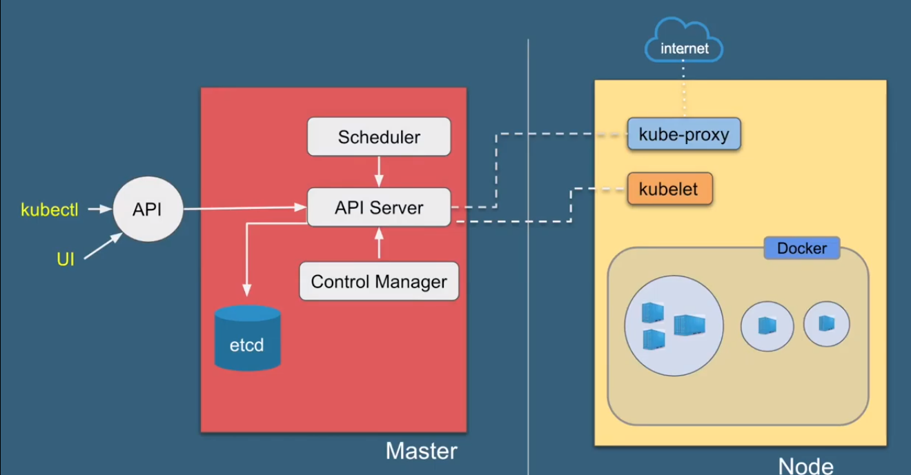
Detailed Architecture

Slide 30
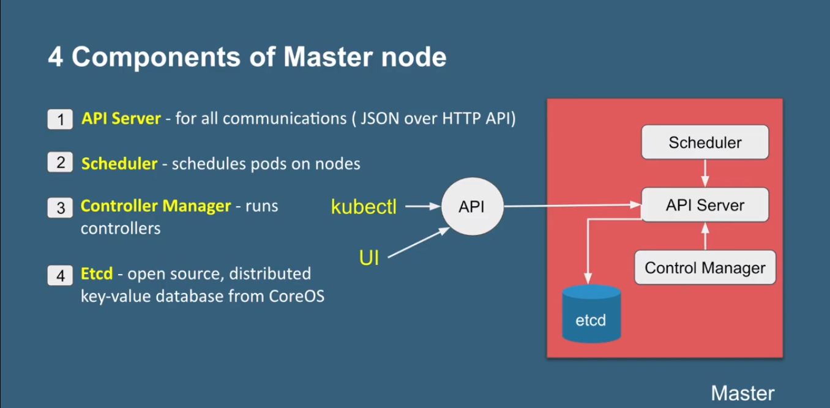
Components

Slide 31
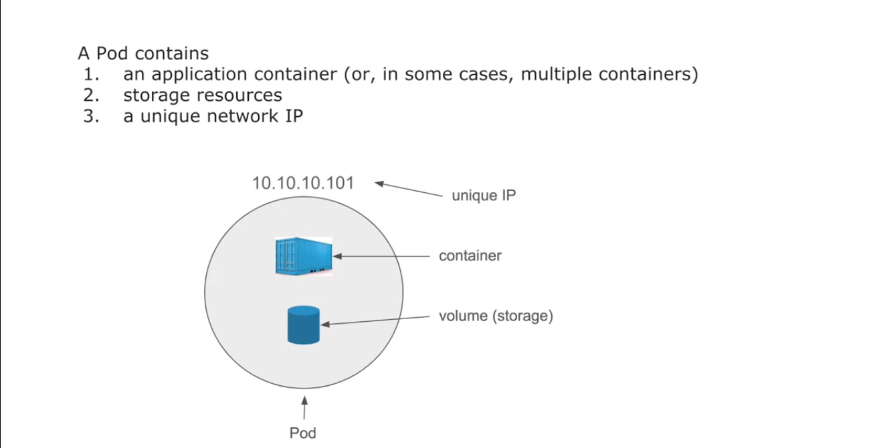
Pod

Slide 32
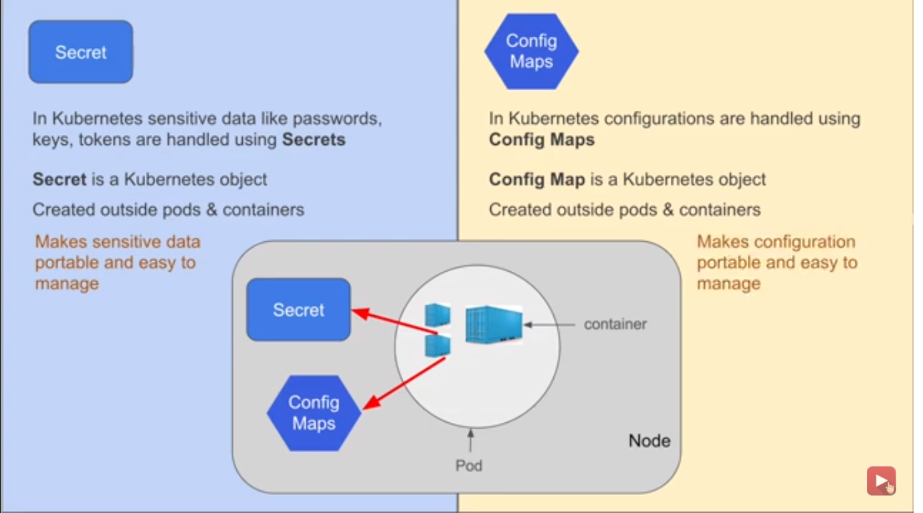
secrets

Slide 33
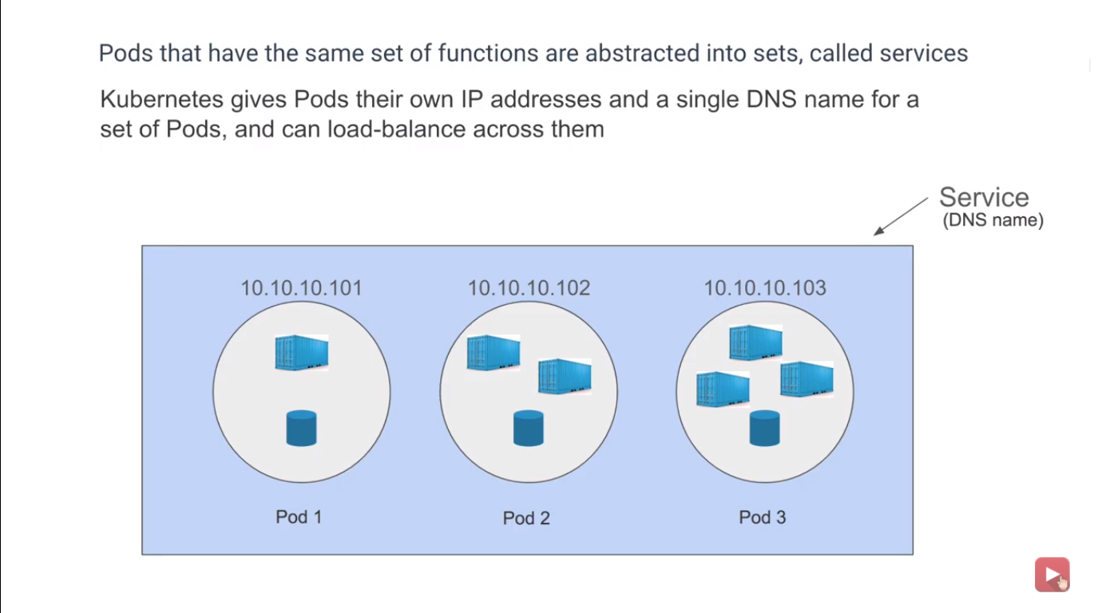
Services

Slide 34
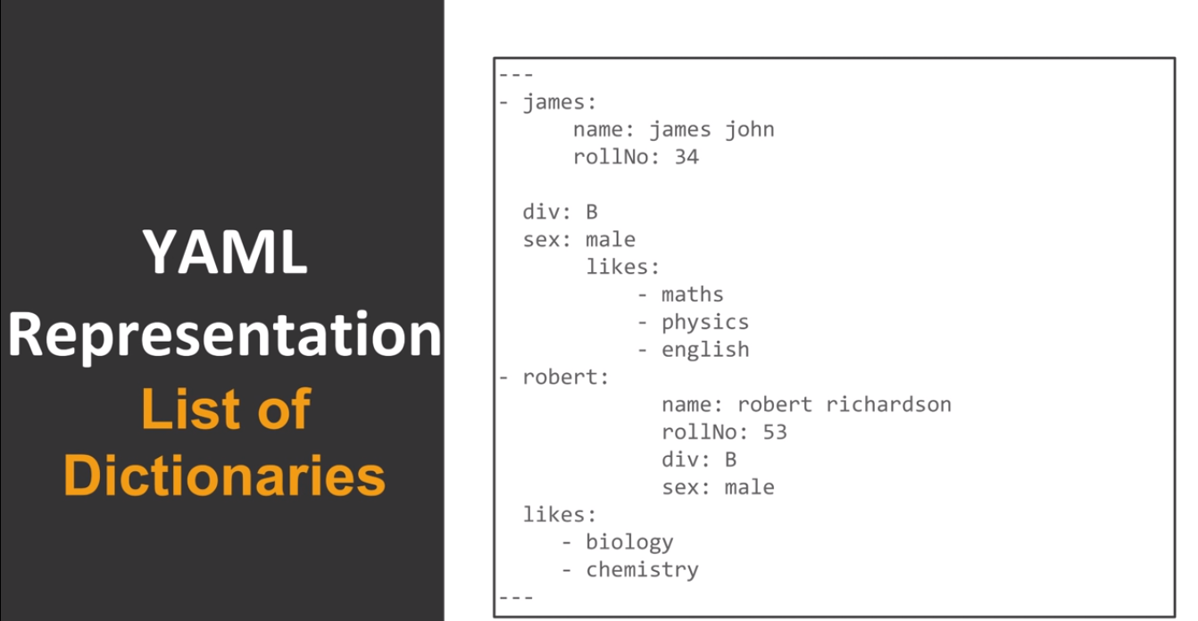
yaml

Slide 35
Case study

Slide 36
Questions???

Slide 37
Thank you!!!!!!!!!!!!!

